Slide 1


Sandeep Samson Ekka
May 8th, 2024

Slide 2

Outline
Executive Summary
Introduction
Methodology
Results
Conclusion
Appendix

Slide 3
Executive Summary
Summary of methodologies
Tree-based Hyperparameter Tuning: The user employed a tree-based approach (e.g., Random Forest) using GridSearchCV to tune hyperparameters. The best parameters were determined based on the validation set.
Logistic Regression Hyperparameter Tuning: Another instance of hyperparameter tuning was conducted for logistic regression, also utilizing GridSearchCV.
Summary of all results
Tree-based Model Accuracy: The accuracy of the tree-based model on the test data was approximately 0.8333333 (rounded to 4 decimal places).
Logistic Regression Hyperparameter Tuning Results: The best parameters for logistic regression were determined as {'C': 0.01, 'penalty': 'l2', 'solver': 'lbfgs'}, and the corresponding accuracy on the test data was around 0.8464285714285713 (rounded to 4 decimal places).

Slide 4
Introduction
Project background and context
Based on the provided code and text, it appears that this is a Dash application for exploring SpaceX launch data. The goal of the project is to analyze the success rate of Falcon 9 rocket launches based on various factors such as payload range, launch site, and booster version category.
The code defines several components:
A dropdown menu (site-dropdown) for selecting a specific launch site or showing all sites.
A pie chart (success-pie-chart) to display the total successful launches count for all sites or for a selected site.
A scatter plot (success-payload-scatter-chart) to show the correlation between payload and launch success.
Problems you want to find answers
Based on the provided code and text, it seems that the project aims to solve several problems:
How to analyze the success rate of Falcon 9 rocket launches based on various factors such as payload range, launch site, and booster version category.
How to predict whether the first stage will land, given data from preceding labs.
How to use this information to determine the cost of a launch, which may help in bidding against SpaceX for rocket launches.

Slide 5

Section 1

Slide 6
Methodology
Executive Summary
Data collection methodology:
Describe how data was collected
Perform data wrangling
Describe how data was processed
Perform exploratory data analysis (EDA) using visualization and SQL
Perform interactive visual analytics using Folium and Plotly Dash
Perform predictive analysis using classification models
How to build, tune, evaluate classification models

Slide 7
Data Collection
Describe how data sets were collected.
You need to present your data collection process use key phrases and flowcharts

Slide 8
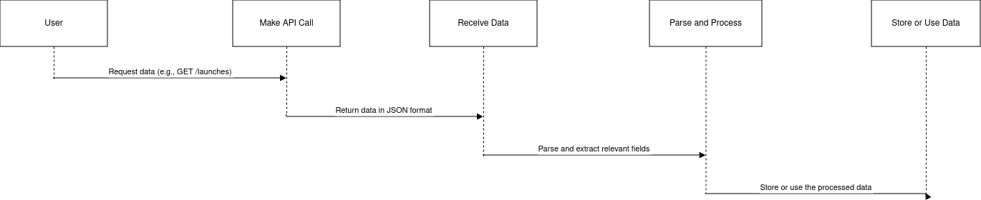
Data Collection – SpaceX API
Data Collection Overview
In this flowchart:
The user requests data from the SpaceX API.
We make a RESTful API call to the desired endpoint (e.g., /launches) using a programming language like Python or JavaScript.
The API responds with a JSON object containing the requested data.
We parse and process this data, extracting relevant fields as needed.
Finally, we store or use the processed data for our intended purposes.
Key Phrases
"SpaceX RESTful APIs"
"JSON data retrieval"
"API endpoint navigation"
"Data parsing and processing"
https://github.com/sandeep-samson/spacex_final_project/blob/e43a50e24d2a9ce54df826f14759c0750770131c/jupyter-labs-spacex-data-collection-api.ipynb

Slide 9
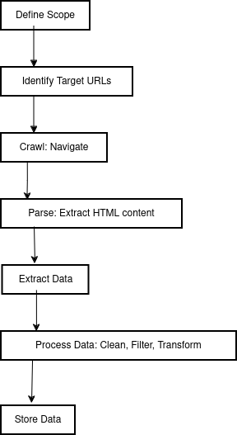
Data Collection - Scraping
Key Phrases: Web scraping involves several key phrases such as:
Crawling: The process of automatically navigating through websites and extracting data.
Scraping: Extracting specific data from a website.
Parsing: Analyzing HTML or XML content to extract relevant information.
Data Extraction: Identifying and collecting specific data elements from a web page.
https://github.com/sandeep-samson/spacex_final_project/blob/e43a50e24d2a9ce54df826f14759c0750770131c/jupyter-labs-webscraping.ipynb

Slide 10
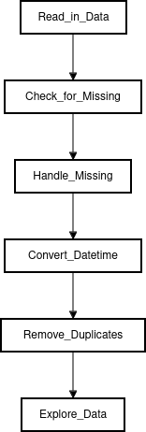
Data Wrangling
Firstly, the data was loaded into a Pandas DataFrame object called df. Then, several operations were performed on this DataFrame to process the data.
Some of these operations include calculating the number of occurrences of different values in the Orbit column using the .value_counts() method. This is likely used to identify the most common orbit types.
Additionally, the percentage of missing values in each attribute was calculated using the .isnull().sum()/len(df)*100 expression. This suggests that there were missing values present in some columns, and it's useful to know how many are missing for each column.
Furthermore, the data type of each column was identified using the .dtypes method. This is useful for understanding what types of data are stored in each column.
Lastly, the df.head(10) expression suggests that a subset of the data (the first 10 rows) was displayed to get an idea of what the data looks like.
Overall, it appears that the data was processed using various Pandas functions and methods to gain insights into its structure, missing values, and content.
To present my data wrangling process, I'll use key phrases and a simple flowchart. Here it is:
Key Phrases:
Data Cleaning
Feature Engineering
Preprocessing
Exploratory Data Analysis (EDA)
Visualization
https://github.com/sandeep-samson/spacex_final_project/blob/e43a50e24d2a9ce54df826f14759c0750770131c/labs-jupyter-spacex-Data%20wrangling.ipynb

Slide 11
EDA with Data Visualization
To start with, a line chart was created to visualize the relationship between the year and success rate. This plot shows that the success rate has been increasing since 2013 until 2020.
Additionally, scatter point charts were used to explore the relationships between different variables. A chart showing the relationship between Flight Number and Launch Site was plotted with the class value as hue. Another chart showed the relationship between Payload and Orbit type.
These plots were used to gain insights into the data and identify potential patterns or trends that could inform future decision-making. By analyzing these visualizations, you can see if there are any correlations between different variables and how they might impact the success rate.
https://github.com/sandeep-samson/spacex_final_project/blob/e43a50e24d2a9ce54df826f14759c0750770131c/edadataviz.ipynb

Slide 12
EDA with SQL
Using bullet point format, summarize the SQL queries you performed
Add the GitHub URL of your completed EDA with SQL notebook, as an external reference and peer-review purpose

Slide 13
Build an Interactive Map with Folium
Summarize what map objects such as markers, circles, lines, etc. you created and added to a folium map
Explain why you added those objects
Add the GitHub URL of your completed interactive map with Folium map, as an external reference and peer-review purpose

Slide 14
Build a Dashboard with Plotly Dash
Summarize what plots/graphs and interactions you have added to a dashboard
Explain why you added those plots and interactions
Add the GitHub URL of your completed Plotly Dash lab, as an external reference and peer-review purpose

Slide 15
Predictive Analysis (Classification)
Summarize how you built, evaluated, improved, and found the best performing classification model
You need present your model development process using key phrases and flowchart
Add the GitHub URL of your completed predictive analysis lab, as an external reference and peer-review purpose

Slide 16
Results
Exploratory data analysis results
Interactive analytics demo in screenshots
Predictive analysis results

Slide 17

Section 2

Slide 18
Flight Number vs. Launch Site
Show a scatter plot of Flight Number vs. Launch Site
Show the screenshot of the scatter plot with explanations

Slide 19
Payload vs. Launch Site
Show a scatter plot of Payload vs. Launch Site
Show the screenshot of the scatter plot with explanations

Slide 20
Success Rate vs. Orbit Type
Show a bar chart for the success rate of each orbit type
Show the screenshot of the scatter plot with explanations

Slide 21
Flight Number vs. Orbit Type
Show a scatter point of Flight number vs. Orbit type
Show the screenshot of the scatter plot with explanations

Slide 22
Payload vs. Orbit Type
Show a scatter point of payload vs. orbit type
Show the screenshot of the scatter plot with explanations

Slide 23
Launch Success Yearly Trend
Show a line chart of yearly average success rate
Show the screenshot of the scatter plot with explanations

Slide 24
All Launch Site Names
Find the names of the unique launch sites
Present your query result with a short explanation here

Slide 25
Launch Site Names Begin with 'CCA'
Find 5 records where launch sites begin with `CCA`
Present your query result with a short explanation here

Slide 26
Total Payload Mass
Calculate the total payload carried by boosters from NASA
Present your query result with a short explanation here

Slide 27
Average Payload Mass by F9 v1.1
Calculate the average payload mass carried by booster version F9 v1.1
Present your query result with a short explanation here

Slide 28
First Successful Ground Landing Date
Find the dates of the first successful landing outcome on ground pad
Present your query result with a short explanation here

Slide 29
Successful Drone Ship Landing with Payload between 4000 and 6000
List the names of boosters which have successfully landed on drone ship and had payload mass greater than 4000 but less than 6000
Present your query result with a short explanation here

Slide 30
Total Number of Successful and Failure Mission Outcomes
Calculate the total number of successful and failure mission outcomes
Present your query result with a short explanation here

Slide 31
Boosters Carried Maximum Payload
List the names of the booster which have carried the maximum payload mass
Present your query result with a short explanation here

Slide 32
2015 Launch Records
List the failed landing_outcomes in drone ship, their booster versions, and launch site names for in year 2015
Present your query result with a short explanation here

Slide 33
Rank Landing Outcomes Between 2010-06-04 and 2017-03-20
Rank the count of landing outcomes (such as Failure (drone ship) or Success (ground pad)) between the date 2010-06-04 and 2017-03-20, in descending order
Present your query result with a short explanation here

Slide 34

Section 3

Slide 35
<Folium Map Screenshot 1>
Replace <Folium map screenshot 1> title with an appropriate title
Explore the generated folium map and make a proper screenshot to include all launch sites’ location markers on a global map
Explain the important elements and findings on the screenshot

Slide 36
<Folium Map Screenshot 2>
Replace <Folium map screenshot 2> title with an appropriate title
Explore the folium map and make a proper screenshot to show the color-labeled launch outcomes on the map
Explain the important elements and findings on the screenshot

Slide 37
<Folium Map Screenshot 3>
Replace <Folium map screenshot 3> title with an appropriate title
Explore the generated folium map and show the screenshot of a selected launch site to its proximities such as railway, highway, coastline, with distance calculated and displayed
Explain the important elements and findings on the screenshot

Slide 38

Section 4

Slide 39
<Dashboard Screenshot 1>
Replace <Dashboard screenshot 1> title with an appropriate title
Show the screenshot of launch success count for all sites, in a piechart
Explain the important elements and findings on the screenshot

Slide 40
<Dashboard Screenshot 2>
Replace <Dashboard screenshot 2> title with an appropriate title
Show the screenshot of the piechart for the launch site with highest launch success ratio
Explain the important elements and findings on the screenshot

Slide 41
<Dashboard Screenshot 3>
Replace <Dashboard screenshot 3> title with an appropriate title
Show screenshots of Payload vs. Launch Outcome scatter plot for all sites, with different payload selected in the range slider
Explain the important elements and findings on the screenshot, such as which payload range or booster version have the largest success rate, etc.

Slide 42

Section 5

Slide 43
Classification Accuracy
Visualize the built model accuracy for all built classification models, in a bar chart
Find which model has the highest classification accuracy

Slide 44
Confusion Matrix
Show the confusion matrix of the best performing model with an explanation

Slide 45
Conclusions
Point 1
Point 2
Point 3
Point 4
…

Slide 46
Appendix
Include any relevant assets like Python code snippets, SQL queries, charts, Notebook outputs, or data sets that you may have created during this project

Slide 47


